Slide 1
Changes in Education
Brain Research
Activities to Increase Intelligence
Common Core

Slide 2
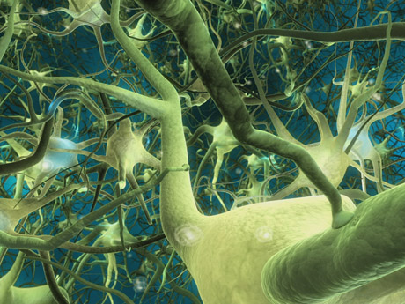
Brain Research
Size, Shape, Function
How do we learn?
Two Hemispheres
Brain and Body
Dominance

Slide 3
Size, Shape, Function

Slide 4
How do we take in information?
Visual: Dorsal and Ventral Pathways
Auditory: Mid brain
Touch: Back brain, to the top
Smell: Front to Center, below prefrontal cortex
Taste: Mouth to Front, below prefrontal cortex

Slide 5
Visual Sensory Modality

Slide 6
Auditory Sensory Modality
Left
Dominant

Slide 7
Touch Sensory Modality

Slide 8
Smell Sensory Modality

Slide 9
Taste Sensory Modality
Information collection and distribution

Slide 10
Two Hemispheres

Slide 11
Brain Dominance
LEFT BRAIN FUNCTIONS uses logic detail oriented facts rule words and language present and past math and science can comprehend knowing acknowledges order/pattern perception knows object name reality based forms strategies practical safe RIGHT BRAIN FUNCTIONS uses feeling "big picture" oriented imagination rules symbols and images present and future philosophy & religion can "get it" (i.e. meaning) believes appreciates spatial perception knows object function fantasy based presents possibilities impetuous risk taking
Test Yourself!

Slide 12
Hemispheric Conflict

Slide 13
Body Dominance

Slide 14
How can we help people learn through all of their senses?
How can we help learners use both sides of their brain?

Slide 15
Brain Gym
Stand up and try these!
Drink Water (Ne pivo)
Hook Up
Figure 8
Cross Over
Brain Buttons
Ears

Slide 16
Hook Up and Figure 8

Slide 17
Cross Over

Slide 18
Brain Buttons

Slide 19
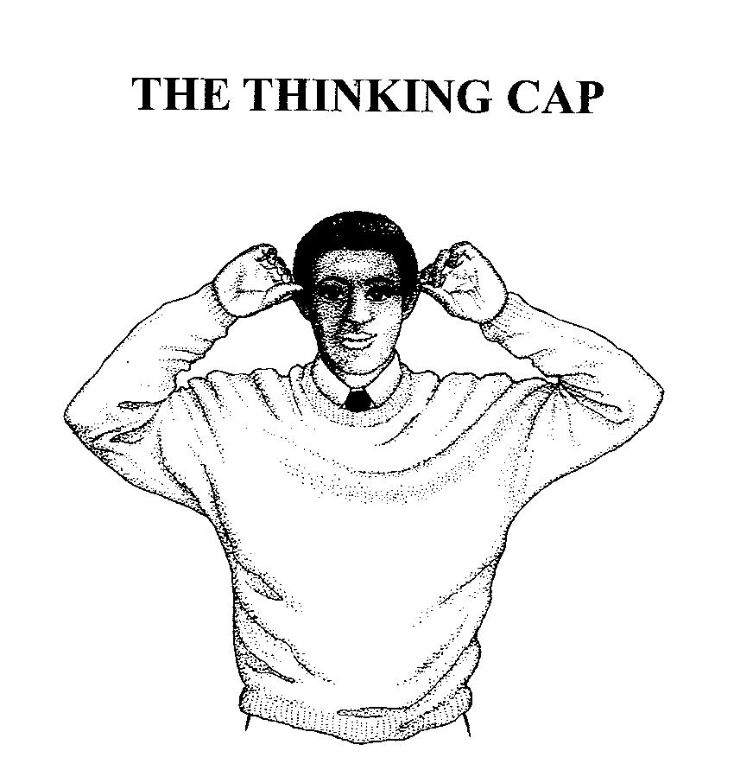
Thinking Cap (Ears)
Calming and redirection
Unroll your ears from front top to bottom

Slide 20
Another Change in Education
Some thing new….. Or is it?

Slide 21
Common Core
A change in standards
English instruction is embedded
Application and use of knowledge
Less memorization
Multiple steps
Analysis and Synthesis

Slide 22
Doing Changes Meaning
Physical movement
Use all of the senses
Construction of meaning and reasoning
Direct contact with stimuli

Slide 23
Language Changes Thinking
*Language defines culture and society.
(Whorf)
*Vocabulary is created by environment
(Snow and Camel)
*Multiple Languages and Intelligence
(Myelin growth through practice)

